Slide 1
DIGITAL LOGIC AND DESIGN PROJECT
Soda Machine Dispenser: FSM and Circuit
By Aazan Iqbal and Tadeo Bennett

Slide 2
01
Finite State Machine

Slide 3
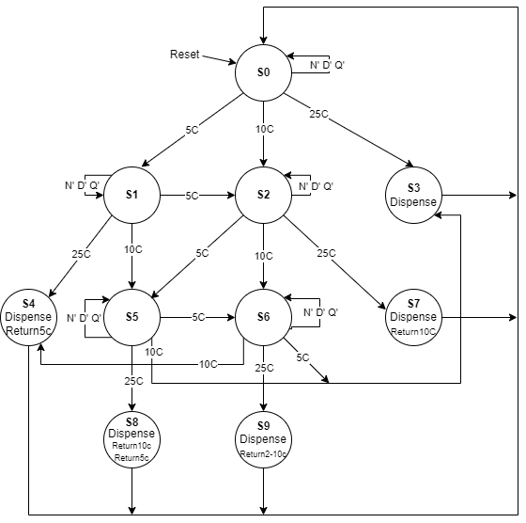
FSM

Slide 4
02
State Transitions
Tables and Equations

Slide 5
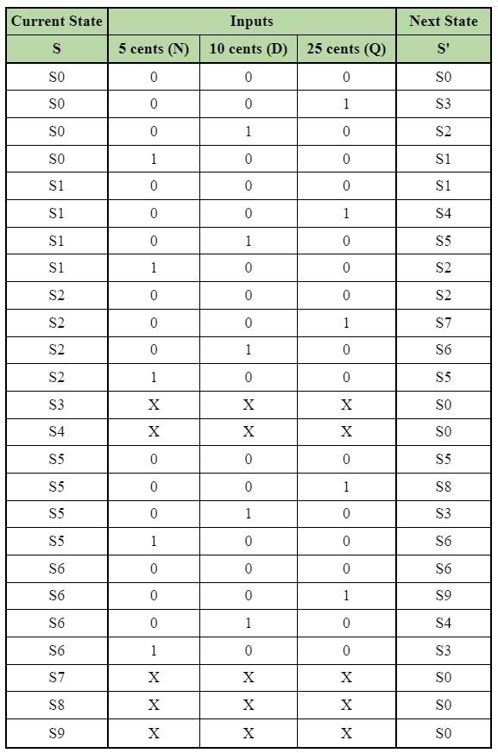
State Transition Table

Slide 6
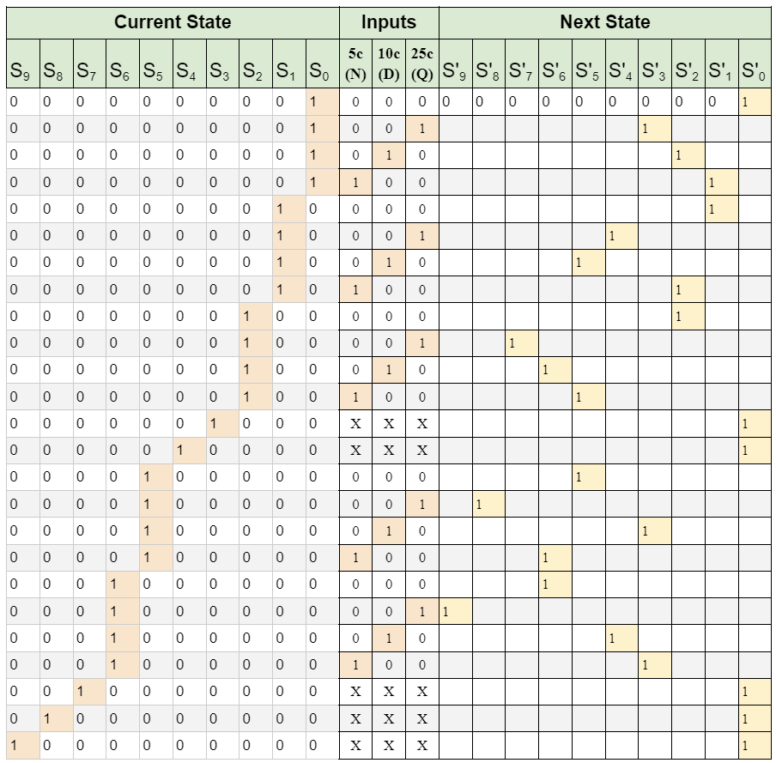
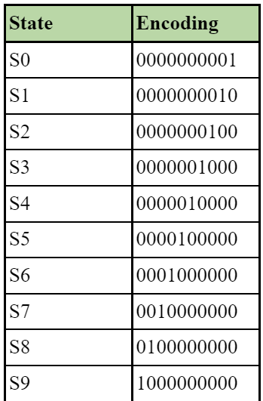
State Encoding Table with Encoded Transitions

Slide 7
State Transition Equations
S’₉ = S₆Q
S’₈ = S₅Q
S’₇ = S₂Q
S’₆ = S₂D + S₅N S₆N’D’Q’
S’₅ = S₁D + S₂N + S₅N’D’Q’
S’₄ = S₁Q + S₆D
S’₃ = S₀Q + S₅D + S₆N
S’₂ = S₀D + S₁N + S₂N’D’Q’
S’₁ = S₀N + S₁N’D’Q’
S’₀ = S₀N’D’Q’ + S₃ + S₄ + S₇ + S₈ + S₉

Slide 8
03
Output Table and
Output Equations

Slide 9
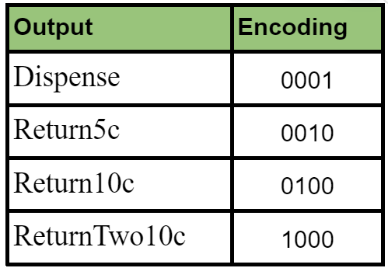
Output Encoding Table

Slide 10
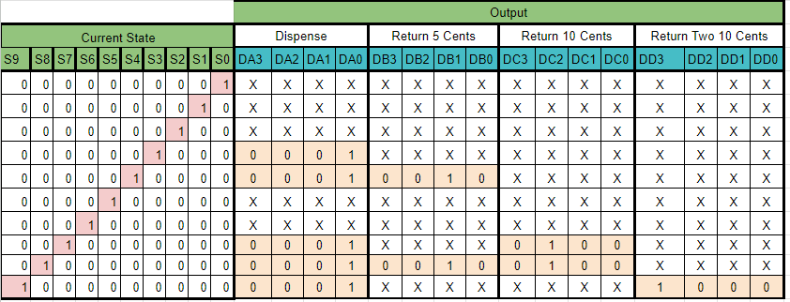
Output Table

Slide 11
Output Equations
Dispense: D_{A0} = S₉ + S₈ + S₇ + S₄ + S₃
Return5c: D_{B0} = S₄ + S₈
Return10c: D_{C0} = S₇ + S₈
ReturnTwo10c: D_{D0} = S₉

Slide 12
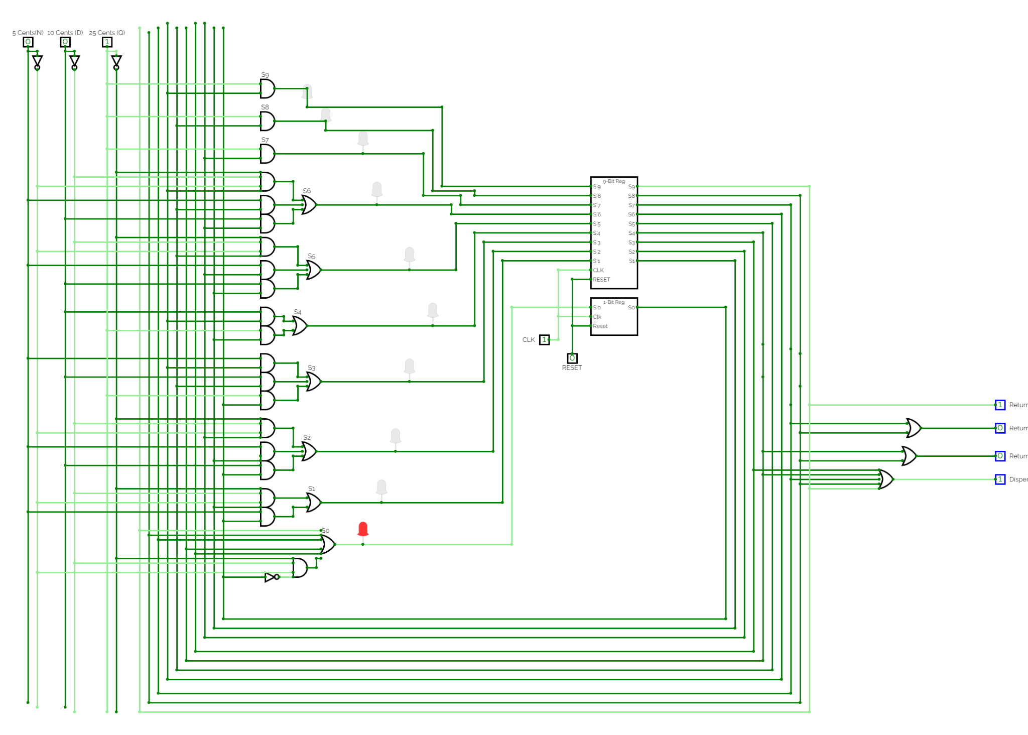
Circuit and Live Demo

Slide 13
THANKS!
Do you have any questions?
Email: 2020152848@ub.edu.bz
2021154344@ub.edu.bz
https://youtu.be/bZQX5rpJgEg
Watch our demonstration on YouTube
https://youtu.be/bZQX5rpJgEg
Please keep this slide for attribution

